Slide 1
Preparing Prefatory Parts of Technical Writing

Slide 2
Elements/Components of a Report with a Standard Organizational Pattern: COVER MATERIALS:
• Cover and title page
• Cover letter or memo (optional)
• Invoice (optional)
• Letter of Transmittal
• Abstract • Acknowledgements
• Executive Summary
• Table of contents
• List of figures or illustrations
• List of tables

Slide 3
How to Write the Elements of the Report:
COVER & TITLE PAGE:
The title page must have the following features:
1. Neat and organized
2. Clearly indicates the subject title in the upper half of the page
3. The title of the report should specifically identify both the report’s function and subject
4. The person or organization writing the report and the person or organization receiving the
report, the date of submittal appear in the lower half of the page

Slide 4
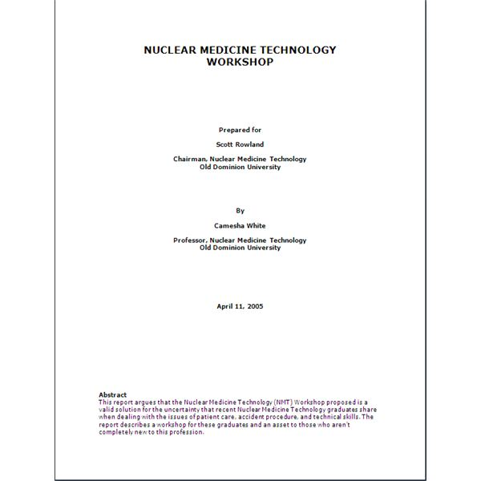

Slide 5
LETTER OR TRANSMITTAL
The letter of transmittal is addressed to the official who authorized the report and is signed by the official authorized to produce the report.
It is the official acknowledgement of completion of the report and includes a statement of its transmittal.

Slide 6
It contains the following information:
1. The title and subject of the report
2. Can include a very brief summary
3. It can acknowledge those who assisted in preparing the report
4. It has a formal tone.

Slide 7
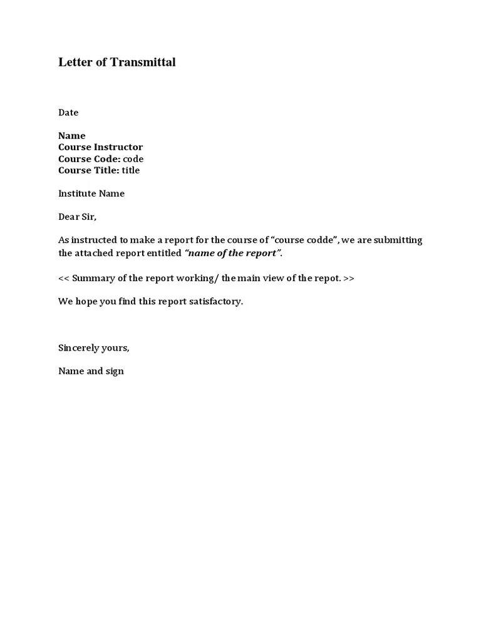

Slide 8
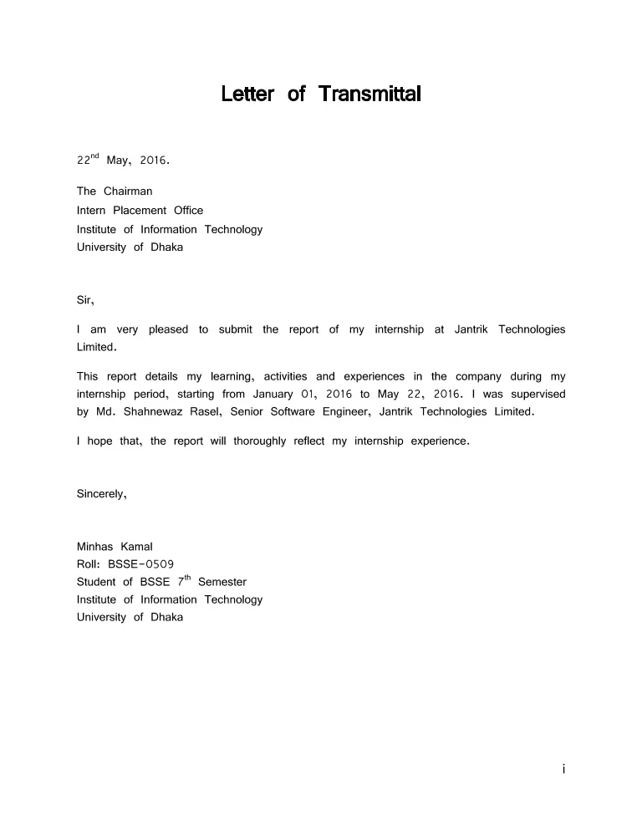

Slide 9
ABSTRACT:
An abstract tells the potential reader the contents of the report.
An abstract gives the gist of essentials of the investigation or the contents of the report.
It may explain the problem and how it was studied.
It gives enough description that would be sufficient for the reader to determine whether the report pertains to their interest or not.
It has a standard word limit from 100-250 words depending on the size of the report.

Slide 10
Abstract
This report investigates the current state of scanner technology and examines the predicted future advancements of scanners. A brief history of the scanner and its operation is initially outlined. The discussion then focuses on the advantages and limitations of the five main types of scanners in common use today: drum, flatbed, sheet-fed, slide, and hand held scanners. The performance of these scanners is examined in relation to four main criteria: resolution, bit-depth, dynamic range and software. It is concluded that further technological advances in these four areas as well as the deployment of new sensor technology will continue to improve the quality of scanned images. It is also suggested that specialized scanners will increasingly be incorporated into other types of technology such as digital cameras.

Slide 11
ABSTRACT
Software Quality Assurance (SQA) is a group of related activities employed throughout the software life cycle to positively influence and quantify the quality of the delivered software. This report provides an overview of SQA, outlining process and product assurance and the methods and technologies typically employed to accomplish them. These methods include audits, assessment activities (e.g., ISO 9000), analysis functions such as reliability prediction, and embedded defect detection methods such as formal inspection. The overview is intended to help the reader identify specific SQA activities for more in-depth study. This report also describes several representative publications on the subject of software quality assurance, assessment standards, and inspection to help the reader find a reliable source for further research. It concludes with an annotated bibliography of public-domain papers on the subject of SQA.

Slide 12
After reading the abstract kindly answer the following questions.
What is the purpose of the report?
2. What are limitations of this report?
3. Write a clear title for this report?
4. How does this study benefit society?
5. Who might be the target readers of this report?

Slide 13
Read the following abstracts of the reports, and revise them if they require improvement:
The risk taking tendency of entrepreneurs of new and old ventures has been objectively obtained using questionnaire and personally administered interviews. Relevant research from a number of business personalities is summarized. The model is intended to be a preliminary concept of risk taking in business. The findings suggest that risk taking has been profitable for entrepreneurs. The research can be modified by adding strategic risk management techniques and decision making.

Slide 14
EXECUTIVE SUMMARY
Executive summaries are written for busy administrators and decision makers who will not have the time to read the entire report.
Also, executive summary is written to save a person from reading a report on issues or subjects in which s/he lacks the required background.

Slide 15
Guidelines for writing a good ES are:
1. Read the entire report to grasp its full content.
2. Your summary should be one-quarter of the original text.
3. Write persuasively to motivate readers to read the report.
4. Discuss your research problem, the purpose of the study, the methodology used, the findings and results. Also, make recommendations if required.
5. Use headings to facilitate reading.
6. Be simple and formal.

Slide 16
TABLE OF CONTENTS/LIST OF FIGURES/TABLES:
A well-constructed table of contents helps readers determine the subject matter of the report, its
organization, and the location of sections of interest. Divide the material into major headings,
subheadings, and further subheadings. Number all the headings for quick reference. Two formats
for numbering headings are:
1. The traditional (I.,I.A.,I.A.1, and so on)
2. The multiple decimal format (1.0,1.1.1,1.1.2,1.2,1.2.1 and so on)

Slide 17
